Slide 1
eRIDE
Estimated risk for novel infectious disease emergence

Slide 2
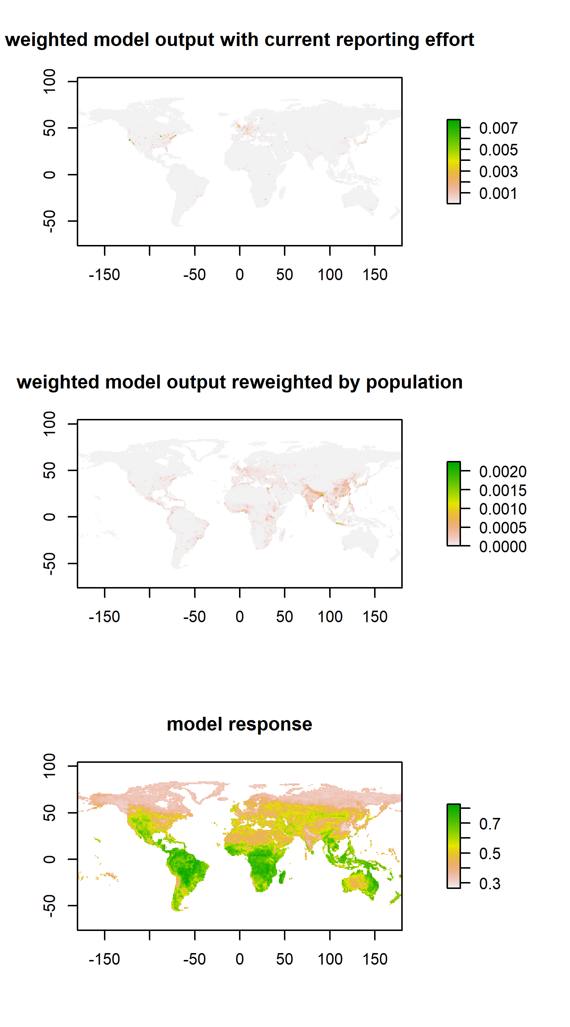
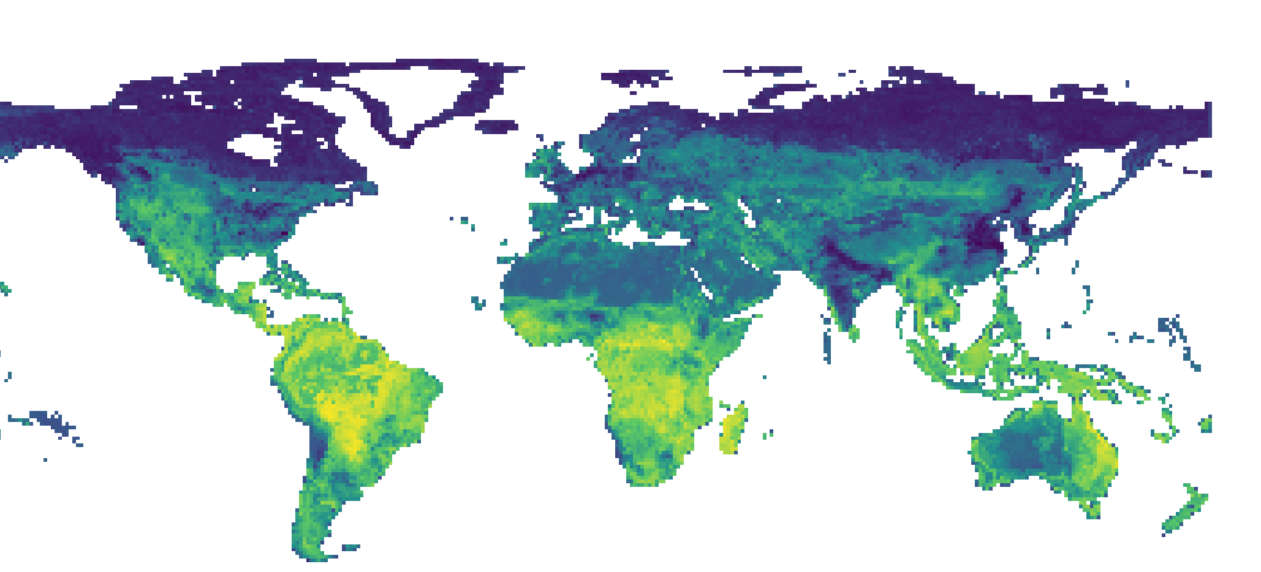
Allen et al. (2019)

Slide 3

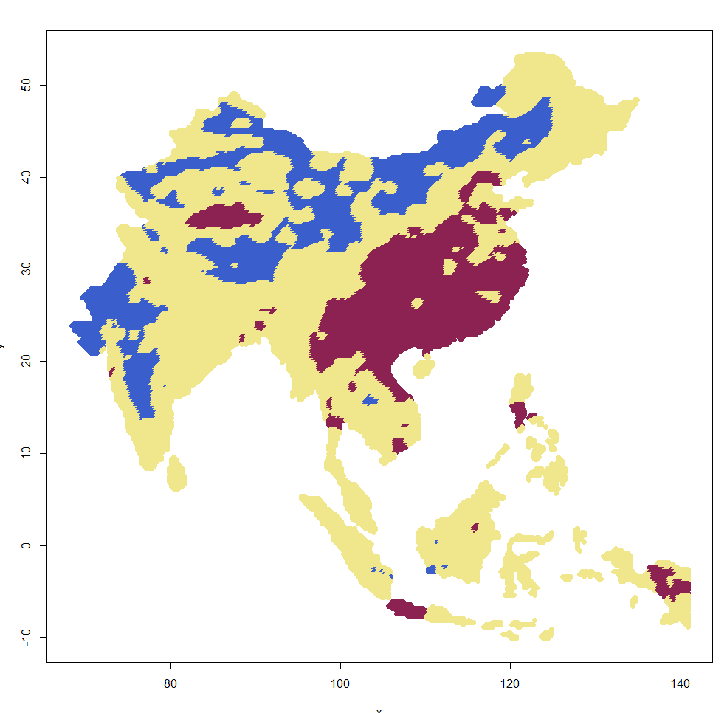
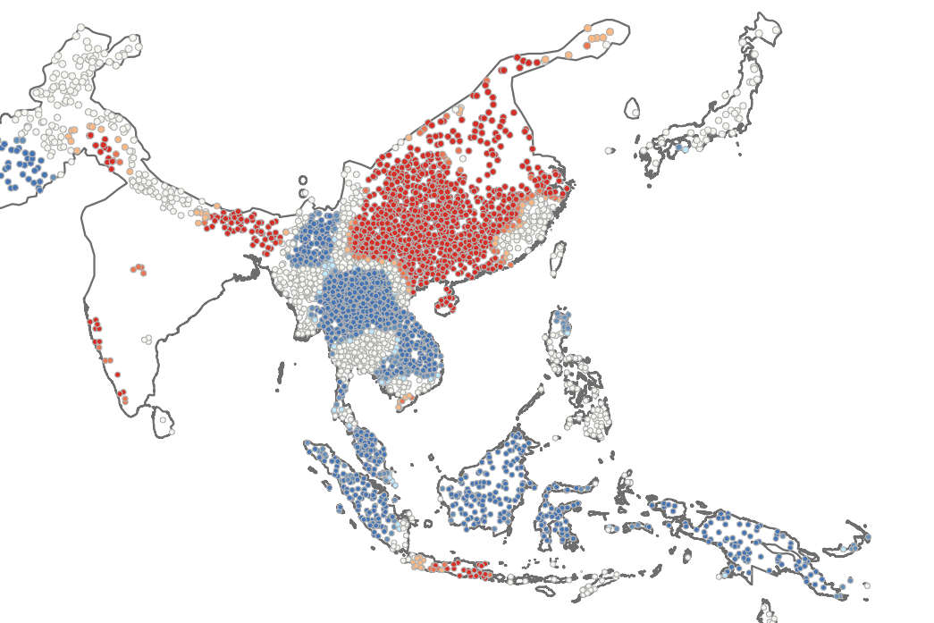
Back to estimated risk for novel infectious disease emergence (eRIDE)
Taklamakan
desert
Hubei:
SARS-Cov-2
1st detections
Hong Kong,
Guandong:
SARS-Cov
1st detections
Manilla
Bombaim
Ho Chi Minh
Bangkok
Kalimantan
Sibil
Hotspot
Neutral
Jacarta
Coldspot

Slide 4
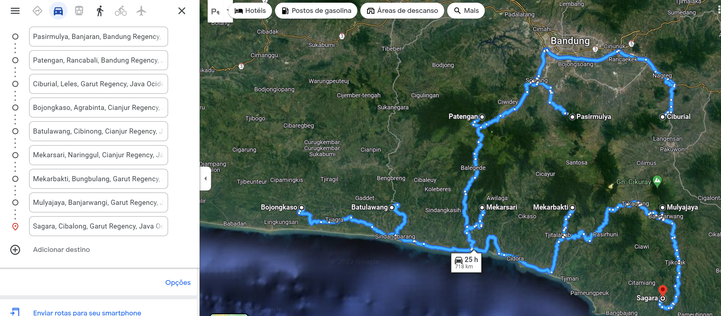
https://goo.gl/maps/YTpDWbwgdobGQy8d7
Complete convergence only happens in West Java

Slide 5

Back to estimated risk for novel infectious disease emergence (eRIDE)
Taklamakan
desert
Hubei:
SARS-Cov-2
1st detections
Hong Kong,
Guandong:
SARS-Cov
1st detections
Manilla
Bombaim
Ho Chi Minh
Bangkok
Kalimantan
Sibil
Hotspot
Neutral
Jacarta
Coldspot

Slide 7

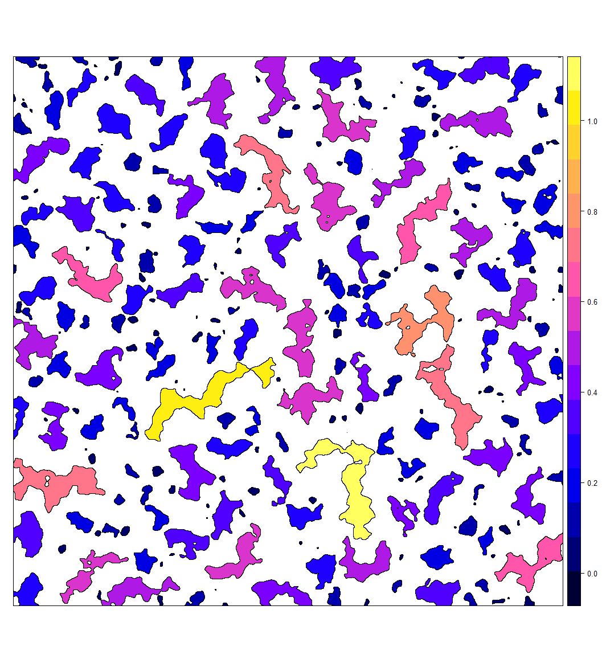

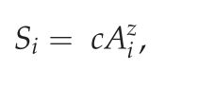
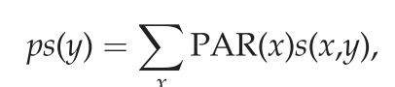
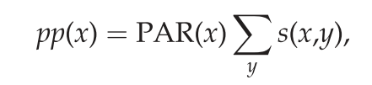
Context: Edges
Hazard
Edge amount
eRIDE
Estimated risk for novel infectious disease emergence: scales linearly with patch biodiversity and patch perimeter
population at risk (PAR) for each pixel: product of the pixel eRIDE and pop density
The pandemic risk following initial spillover depends on subsequent human to human transmission and thus will be driven by pop density and connectivity (Dijkstra’s algorithm).
Biodidiversity
in a forest patch
eRIDE ~
PAR = eRIDE x Pop density
Received
Generated
Notes:
An eRIDE index (sumof the product of number of edge pixels from each patch and their corresponding patch bio- diversities) were calculated within a 20 X 20 moving window for each pixel of these data. The
A division index (number of unique patches), an edge density index (number of edge pixels) and an eRIDE index (sumof the product of number of edge pixels from each patch and their corresponding patch bio- diversities) were calculated within a 20 ? 20 moving window for each pixel of these data. The estimated population at risk (PAR) for each pixel was defined as the product of the pixel eRIDE index and the population density at that location.

Slide 8
OneImpact (Niebuhr et al)
The approach we developed allows to assess cumulative risks (or area under influence of risk) of areas of high potential contact rates using population density and wildlife (mammals and birds), and it can be applied in spatial planning planning and primary prevention actions.
Methods: The ZoI metrics presented are computationally efficient and flexible and can be computed in R and GRASS GIS through the oneimpact R package.
Simulations show the ZoI of the nearest feature and the cumulative ZoI cannot be distinguished when the occurrence of features is rare and ZoI is small, and when features are clustered and ZoI is large. In our empirical analysis we found strong evidence of cumulative impacts of private cottages and tourist resorts on reindeer, with ZoI radii of 10 and 20 km, respectively. While the impact of a single private cottage was negligible, the cumulative impact of an aggregation of cottages could be larger than that of a tourist resort. Hence, measuring only the ZoI of the nearest private cottage would underestimate the impact of the widespread phenomena of cabin villages.

Slide 9
eRIDE 1
Gravity model
OneImpact
eRIDE 2
Gravity model
OneImpact

Slide 10
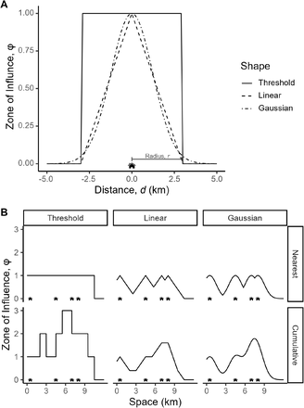
Any edge could be a zone of influence
Reclass edges as 1-0
Define decay
Edges close to areas with high biodiversity
are more dangerous?

Slide 11
Any edge could be a zone of influence
Reclass edges as 1-0
Define decay
Edges close to areas with high biodiversity
are more dangerous?

Slide 12
Hazard
Edge amount
eRIDE type 1
Estimated risk for novel infectious disease emergence: scales linearly with patch biodiversity and patch perimeter
Biodidiversity
in a forest patch
30 m
Patch-level
Vertebrate parameters

Slide 13
eRIDE types
Hazard
Edge amount
eRIDE type 1
Hazard - eRIDE type 1
Assumption: Estimated risk for novel infectious disease emergence: scales linearly with patch biodiversity and patch perimeter
Assumption: Estimated risk for novel infectious disease emergence: scales XXXX with macro-scale diversity
Biodidiversity
in a forest patch
18 km
Macro-scale level
Habitat for Mammals and Birds
30 m
Patch-level
Vertebrate parameters

Slide 14
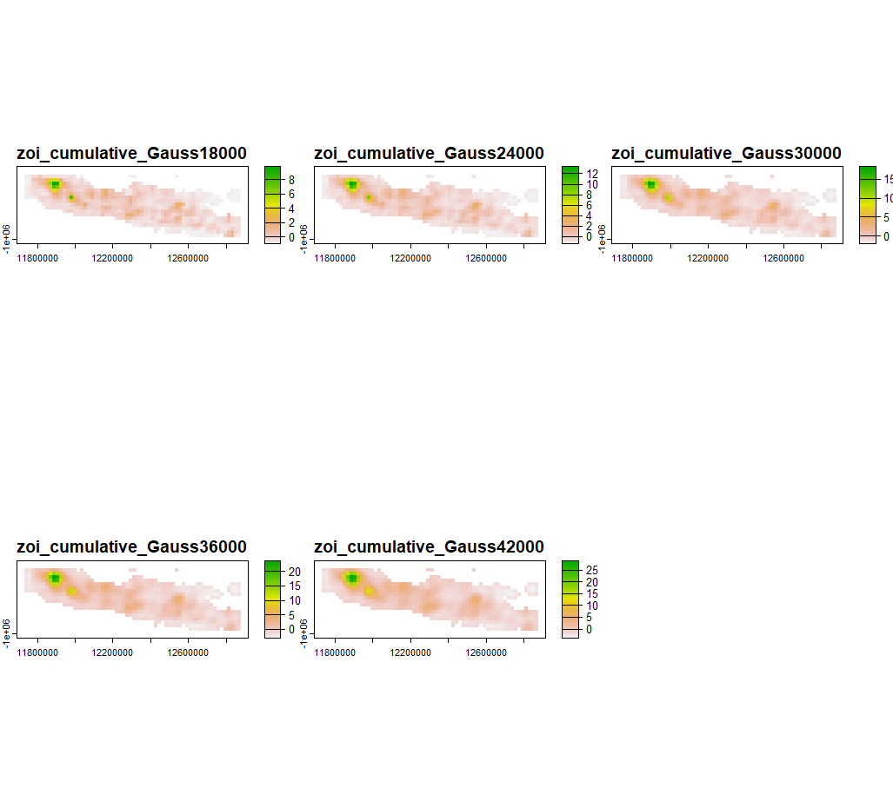
‘Macro’ eRIDE from area of habitat data (birds and mammals)

Slide 15

Issues
~600 x
30 m
18 km

Slide 16
Ideas
Disaggregation or Aggregation
Scale test
Moving window for 30 m eRIDE

